Slide 1
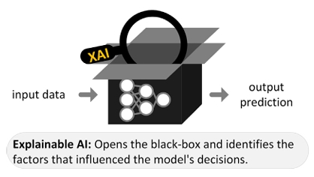
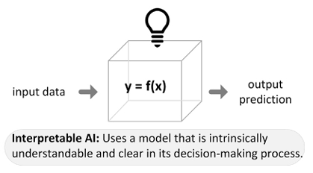



Open the Black-box and Allow Explainable AI (XAI) to Optimize Soilless Agriculture.
Jason Noble
June 29, 2025
Data
Input
Output
User
Seifi, 2025
Notes:
Welcome everyone. I am Jason Noble.

Slide 2
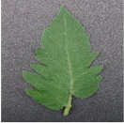
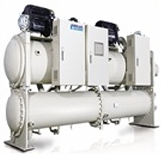
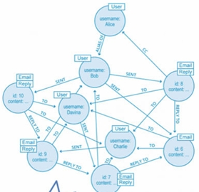
This talk examines how XAI can advance agriculture by improving health, resource mgmt, and trust in its logic
Plant Health
Optimize Resources
Interpretable Predictions

Slide 3
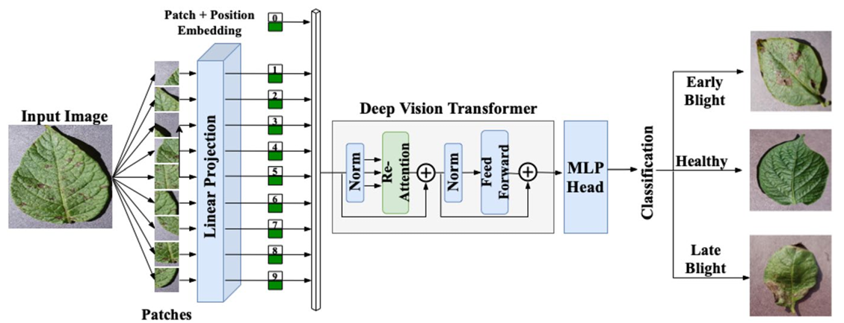
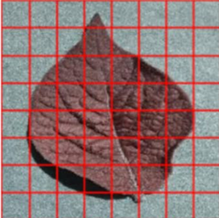
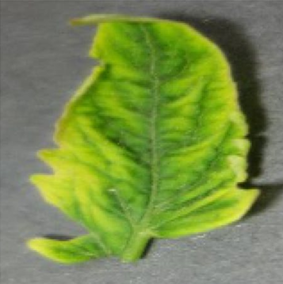
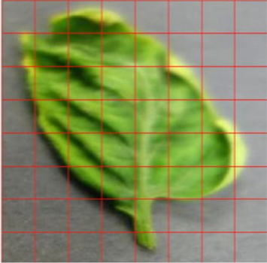
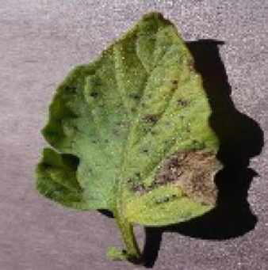
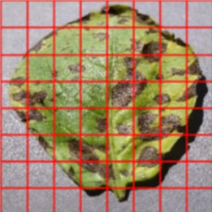
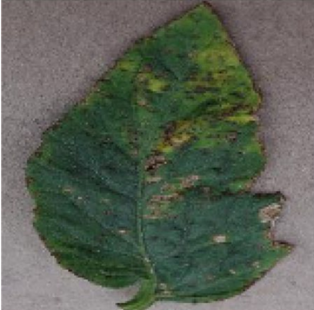
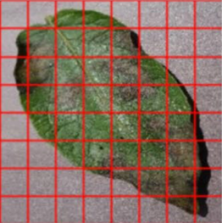
XAI improves the ML boost to crop yield through the early and accurate identification of plant diseases
Data Collection and Processing
Model Training
Performance Evaluation
XAI Model Deployment
D V T
Classification
SHAP XAI
Kamal, 2025
Notes:
Deep vision transformer
Multilayer perceptron

Slide 4
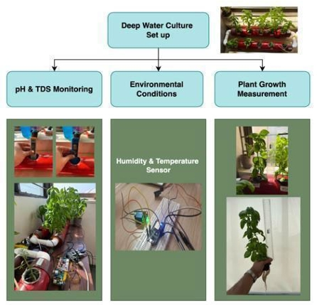
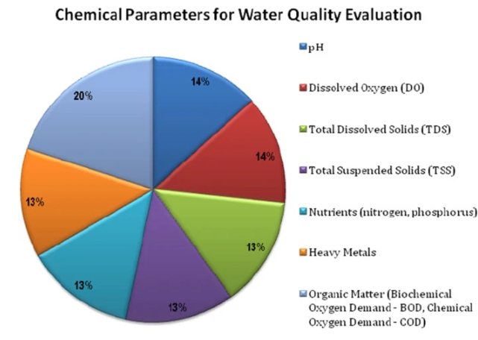
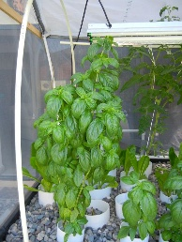
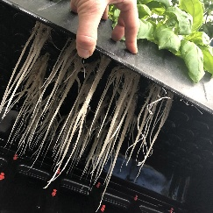
Growth prediction models provide high accuracy, but require XAI to understand feature contributions
Aquaponic
Aeroponic
Kadam, 2025
Nallakaruppan, 2024
Notes:
Can simultaneously evaluate chemical parameters within the water (as shown) or physical parameters (discussed later)

Slide 5
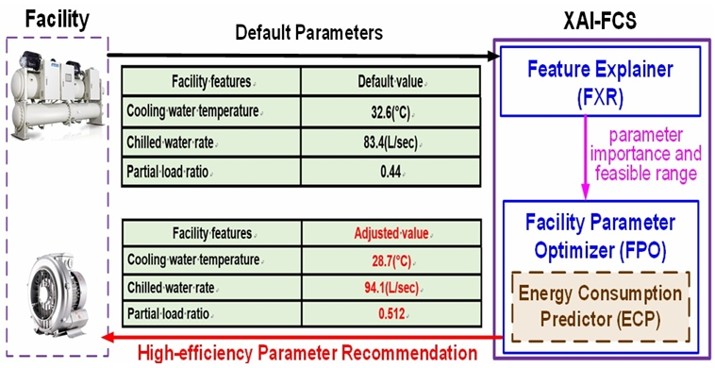
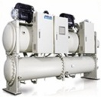
Models explained with XAI present clear parameter settings to minimize energy and water usage
Tieng, 2025
Notes:
Facility control system

Slide 6
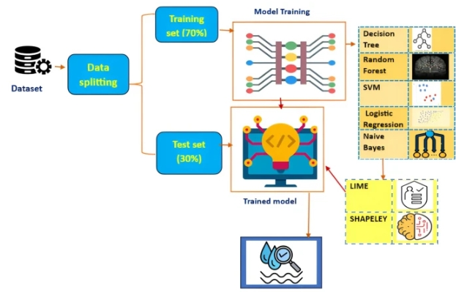
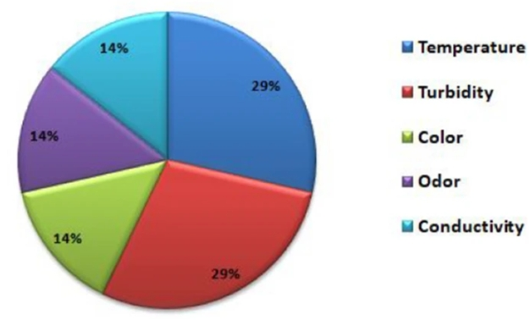
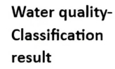
XAI optimizes water management by expanding the scope and accuracy of quality monitoring
Nallakaruppan, 2024
Notes:
SHapley Additive explanations (SHAPs) and Local Interpretable Model-agnostic Explanations (LIMEs), are used to interpret the model. These methods balance the feature distribution with individual model interpretation.

Slide 7
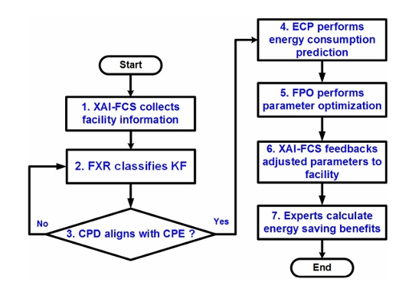
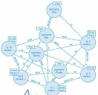
Why do you need an XAI to provide insight into predictions and parameters?
For Reducing Energy
ISSUES:
# Variables
Training
Feature ID
Precision
Transference
Time
Examples
Tieng, 2025

Slide 8
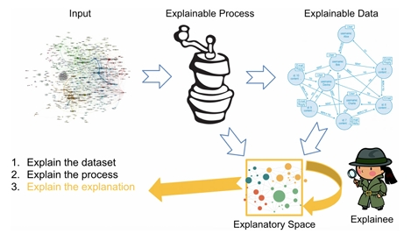
Explanatory AI (YAI) can tailor explanations to each users needs, increasing utility and credibility.
Sovrano, 2022
Notes:
(at two levels Network and device)

Slide 9
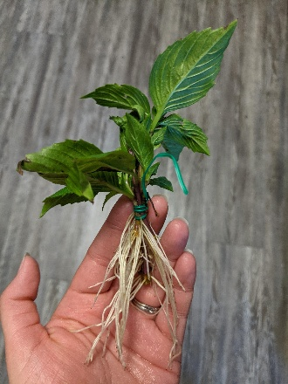
To review, XAI is capable of increasing user trust, resource conservation, and crop production
Questions?

Slide 10
Resources
Kadam, S., et al. (2025). Machine Learning and Explainable AI for Thai Basil Growth Prediction in Hydroponics. IEEE Access, 13, 99489. https://doi.org/10.1109/ACCESS.2025.3576440
Kamal, S., et al. (2025). DVTXAI: A novel deep vision transformer with XAI-based framework and application in agriculture. The Journal of Supercomputing, 81, 280. https://doi.org/10.1007/s11227-024-06494-y
Nallakaruppan, M.K., et al. Reliable water quality prediction and parametric analysis using explainable AI models. Scientific Reports 14, 7520 (2024). https://doi.org/10.1038/s41598-024-56775-y
Seifi, S., et al. Complying with the EU AI Act: Innovations in explainable and user-centric hand gesture recognition. Machine Learning with Applications, 20. https://doi.org/10.1016/j.mlwa.2025.100655
Sovrano, F., & Vitali, F. (2024). Explanatory artificial intelligence (YAI): human-centered explanations of explainable AI and complex data. Data Mining and Knowledge Discovery, 38, 3141–3168. https://doi.org/10.1007/s10618-022-00872-x
Tieng, H., et al. (2025). Explainable AI-based facility control system for energy saving and carbon reduction. Journal of Mechanical Science and Technology, 39(4), 2301–2310. http://doi.org/10.1007/s12206-025-0348-5

